Slide 1

Introduction to Neural Networks
Presented by:
Elizer Ponio Jr.
Department of Computer Science
College of Computing and Information Technologies

Slide 2
Outline
What is a Neural Network?
How Neural Networks work?
How to train a Neural Network

Slide 3
Neural Networks
Also known as artificial neural networks (ANNs) are a subset of machine learning and are at the heart of deep learning algorithms.
Their name and structure are inspired by the human brain, mimicking the way that biological neurons signal to one another.

Slide 4
Neural Networks
It is comprised of layers of neurons or nodes, containing an input layer, one or more hidden layers, and an output layer.

Slide 5
Neuron
Neuron
Neuron
Neuron
Neuron
Input Layer
Hidden Layer
Output Layer

Slide 6
Neural Networks
Each node, or artificial neuron, connects to another and has an associated weight and threshold (bias).

Slide 7


$$b$$
$$b$$
bias (b)
weight(w)
bias (b)
weight(w)
weight(w)
bias (b)
weight(w)
weight(w)
weight(w)
Input Layer
Hidden Layer
Output Layer

Slide 8

What is a Neural Network?
How Neural Networks work?
How to train a Neural Network

Slide 9
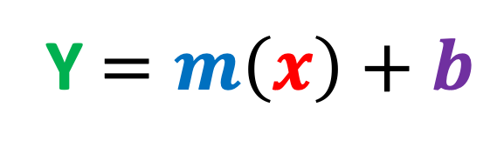
How do Neural Networks work?
Think of each individual neurons as its own linear regression model, composed of input data, weights, a bias (or threshold), and an output.
Y $=m\left(x\right)+b$

Slide 10

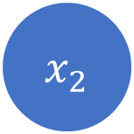

$${ x}_{1}$$
Activation function
$${Input: x}_{1},x_{2}$$
Activation function
$${ x}_{2}$$
Activation function
Input Layer
Hidden Layer
Output Layer

Slide 11





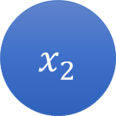



$$Weights: w_{11},w_{12} ,w_{21},w_{22},w_{3},w_{4}$$
$${ x}_{1}$$
$$w_{11}$$
Activation function
$$w_{3}$$
$$w_{12}$$
Activation function
$$w_{21}$$
$$w_{4}$$
$${ x}_{2}$$
$$w_{22}$$
Activation function
Input Layer
Hidden Layer
Output Layer

Slide 12
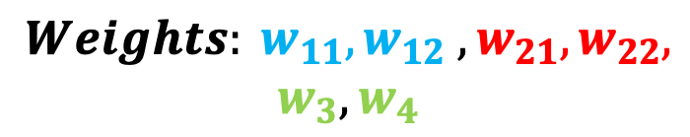





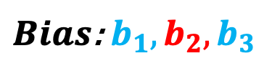
$$b$$
$$b$$
$$b_{1}$$
$$Weights: w_{11},w_{12} ,w_{21},w_{22},$$
$$w_{3},w_{4}$$
$$b_{2}$$
$${ x}_{1}$$
$$w_{11}$$
Activation function
$${ b}_{3}$$
$$b_{2}$$
$Bias$: $b_{1}, b_{2},b_{3}$
$$w_{3}$$
$$w_{12}$$
Activation function
$$w_{21}$$
$$w_{4}$$
$${ x}_{2}$$
$$w_{22}$$
Activation function
Input Layer
Hidden Layer
Output Layer

Slide 13
How do Neural Networks work?
Once an input layer is determined, weights are assigned.
These weights help determine the importance of any given variable, with larger ones contributing more significantly to the output compared to other inputs.
All inputs are then multiplied by their respective weights and then summed.

Slide 14


$$b$$
$$b_{1}$$
$$z_{1}$$
$${ x}_{1}$$
$$w_{11}$$
Activation function
$$z_{1}= w_{11} x_{1}+w_{21} x_{2}+b_{1}$$
Activation function
$$w_{21}$$
$${ x}_{2}$$
Activation function
Input Layer
Hidden Layer
Output Layer

Slide 15



$$b$$
$$z_{1}$$
$$b_{2}$$
$${ x}_{1}$$
Activation function
$$w_{12}$$
Activation function
$$z_{2}$$
$${ x}_{2}$$
Activation function
$$z_{2}= w_{12} x_{1}+w_{22} x_{2}+b_{2}$$
$$w_{22}$$
Input Layer
Hidden Layer
Output Layer

Slide 16
How do Neural Networks work?
Afterward, the output is passed through an activation function, which determines the output.
If that output exceeds a given threshold, it “fires” (or activates) the neuron, passing data to the next layer in the network.
This results in the output of one node becoming in the input of the next node. This process of passing data from one layer to the next layer defines this neural network as a feedforward network.

Slide 17



$$b$$
$$b_{1}$$
$$z_{1}$$
Activation functions:
Sigmoid function
ReLU
Softmax
$$b_{2}$$
$${ x}_{1}$$
$$w_{11}$$
Activation function
$$w_{12}$$
Activation function
$$w_{21}$$
$$z_{2}$$
$${ x}_{2}$$
Activation function
$$w_{22}$$
$$h_{1}= σ(z_{1})$$
Input Layer
Hidden Layer
Output Layer

Slide 18

$$b$$
$$b_{1}$$
$$z_{1}$$
$$b_{2}$$
$${ x}_{1}$$
$$w_{11}$$
Activation function
$$h_{1}$$
$$w_{12}$$
Activation function
$$w_{21}$$
$$z_{2}$$
$${ x}_{2}$$
Activation function
$$w_{22}$$
$$h_{1}= σ(z_{1})$$
Input Layer
Hidden Layer
Output Layer

Slide 19



$$b$$
$$b_{1}$$
$$z_{1}$$
$$b_{2}$$
$${ x}_{1}$$
$$w_{11}$$
Activation function
$$h_{1}$$
$$w_{12}$$
Activation function
$$w_{21}$$
$$z_{2}$$
$${ x}_{2}$$
Activation function
$$h_{2}$$
$$w_{22}$$
$$h_{2}= σ(z_{2})$$
Input Layer
Hidden Layer
Output Layer

Slide 20






$$b$$
$$b$$
$$z_{1}$$
$${ x}_{1}$$
Activation function
$$h_{1}$$
$$b_{3}$$
$$w_{3}$$
$$z_{3}$$
Activation function
$$z_{2}$$
$$w_{4}$$
$${ x}_{2}$$
Activation function
$$h_{2}$$
$$z_{3}= w_{3} h_{1}+w_{4} h_{2}+b_{3}$$
Input Layer
Hidden Layer
Output Layer

Slide 21


$$b$$
$$b$$
$$z_{1}$$
$${ x}_{1}$$
Activation function
$$h_{1}$$
$$b_{3}$$
$$w_{3}$$
$$z_{3}$$
Activation function
$$\hat{p}$$
$$z_{2}$$
$$w_{4}$$
$${ x}_{2}$$
Activation function
$$h_{2}$$
$$\hat{p}=σ(z_{3})$$
Input Layer
Hidden Layer
Output Layer

Slide 22
What is a Neural Network?
How Neural Networks work?
How to train a Neural Network

Slide 23
Backpropagation

Slide 24

$${ x}_{1}$$
Activation function
$$\hat{p}$$
Activation function
Loss function
$${ x}_{2}$$
Activation function
Calculate Loss
Input Layer
Hidden Layer
Output Layer
FORWARD PASS (MAKE PREDICTION)

Slide 25

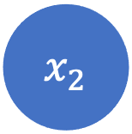
$${ x}_{1}$$
Activation function
$$\hat{p}$$
Activation function
Loss function
$${ x}_{2}$$
Activation function
Calculate Loss
Input Layer
Hidden Layer
Output Layer
BACK PROPAGATION (Adjust all weights to reduce loss)

Slide 26
Back Propagation Example

Slide 27

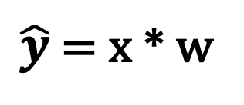
x
$$\hat{y}$$
w
$\hat{y}$ = x * w
Input Layer
Output Layer

Slide 28
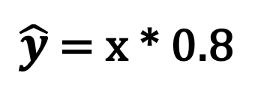
x
Let us initialize weight (w) to 0.8
$$\hat{y}$$
w = 0.8
$\hat{y}$ = x * 0.8
Input Layer
Output Layer

Slide 29
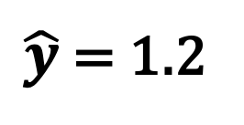
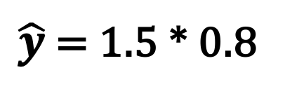
Input (x) | Actual Output (y)
1.5 | 0.5
x
$$\hat{y}$$
w = 0.8
$\hat{y}$ = 1.5 * 0.8
$\hat{y}$ = 1.2
Input Layer
Output Layer

Slide 30
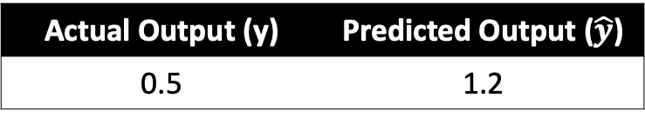
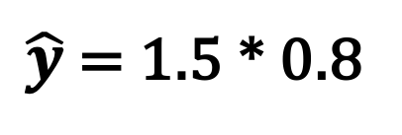
Input (x) | Actual Output (y)
1.5 | 0.5
x
$$\hat{y}$$
w = 0.8
$\hat{y}$ = 1.5 * 0.8
$\hat{y}$ = 1.2
Actual Output (y) | Predicted Output ($\hat{y}$)
0.5 | 1.2
Input Layer
Output Layer

Slide 31
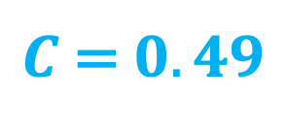
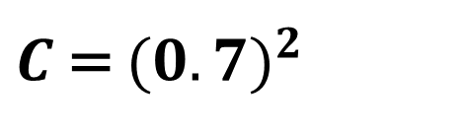
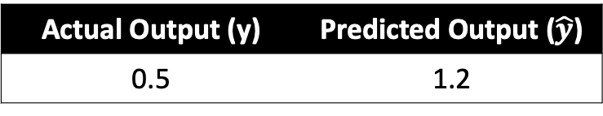
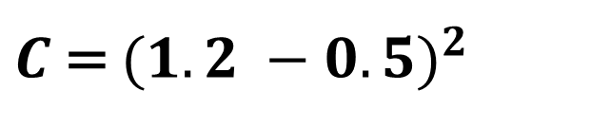
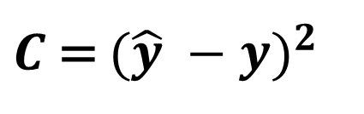
Let us use Mean Squared Error (MSE) as our cost function (C)
Actual Output (y) | Predicted Output ($\hat{y}$)
0.5 | 1.2
x
$$\hat{y}$$
w = 0.8
$C$ = ${(\hat{y} −y)}^{2}$
$C$ = ${(1.2 −0.5)}^{2}$
$C$ = ${(0.7)}^{2}$
$C$ = $0.49$
Input Layer
Output Layer

Slide 32

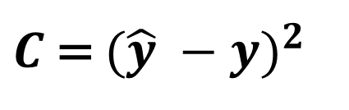
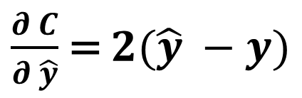
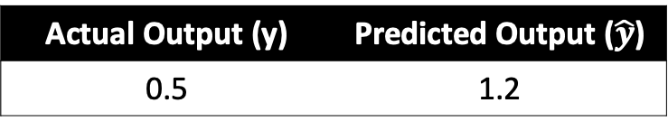
x
$$\hat{y}$$
w = 0.8
Actual Output (y)
Input Layer
Output Layer
Actual Output (y) | Predicted Output ($\hat{y}$)
0.5 | 1.2
$C$ = ${(\hat{y} −y)}^{2}$
Weight
$\frac{∂ C}{∂ \hat{y}}$ = $2(\hat{y} −y)$

Slide 33
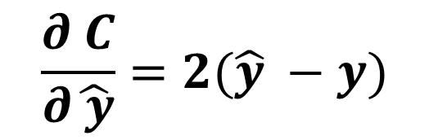
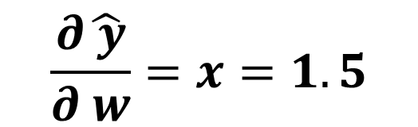
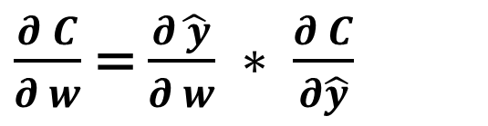
x
$$\hat{y}$$
w = 0.8
Actual Output (y)
Input Layer
Output Layer
$\frac{∂ C}{∂ w}$ = $\frac{∂\hat{ y}}{∂ w} ∗ \frac{∂ C}{∂\hat{y}}$
$$\frac{∂\hat{ y}}{∂ w}=x=1.5$$
Weight
$$\frac{∂ C}{∂\hat{ y}}=2(\hat{y} −y)$$

Slide 34
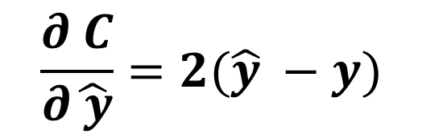

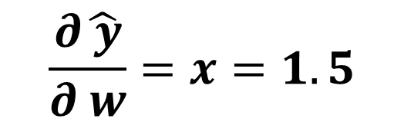


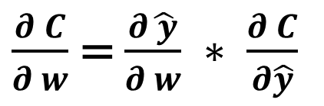
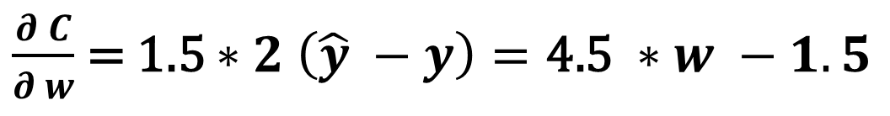




x
$$\hat{y}$$
w = 0.8
Actual Output (y)
Input Layer
Output Layer
$\frac{∂ C}{∂ w}$ = $\frac{∂\hat{ y}}{∂ w} ∗ \frac{∂ C}{∂\hat{y}}$
$$\frac{∂\hat{ y}}{∂ w}=x=1.5$$
$$\frac{∂ C}{∂\hat{ y}}=2(\hat{y} −y)$$
Weight
$\frac{∂ C}{∂ w}$ = 1.5 $∗2 \left(\hat{y} −y\right)=\text{4.5 }∗w −1.5$

Slide 35
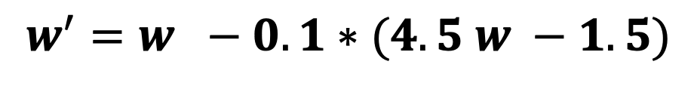
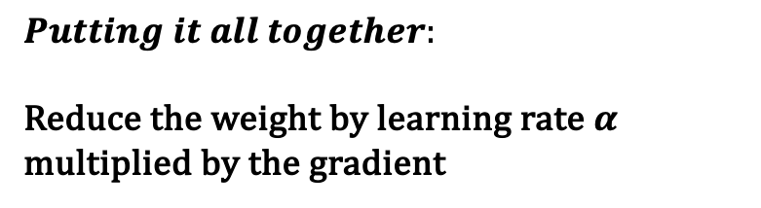
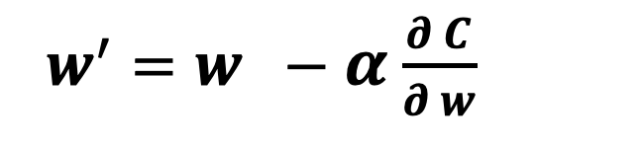
x
$$\hat{y}$$
w = 0.8
Actual Output (y)
Input Layer
Output Layer
$$Putting it all together:$$
Reduce the weight by learning rate $α$ multiplied by the gradient
Weight
$w^{′}=w −α$ $\frac{∂ C}{∂ w}$
$$w^{′}=w −0.1∗(4.5 w −1.5)$$

Slide 36
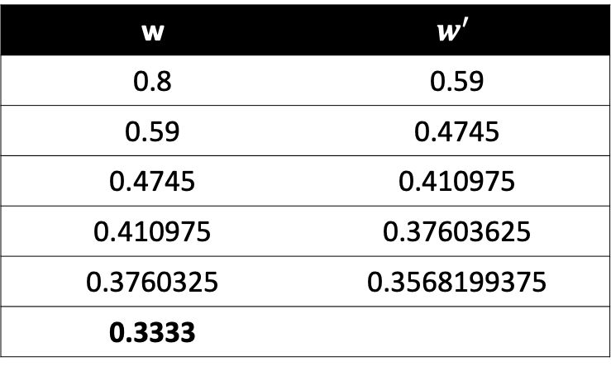
x
$$\hat{y}$$
w = 0.8
Actual Output (y)
Input Layer
Output Layer
w | $$w^{′}$$
0.8 | 0.59
0.59 | 0.4745
0.4745 | 0.410975
0.410975 | 0.37603625
0.3760325 | 0.3568199375
0.3333
Weight

Slide 37

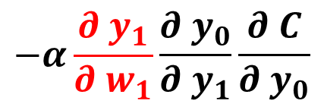


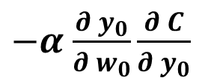



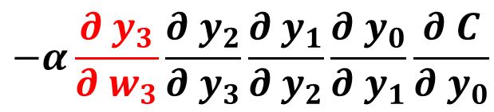



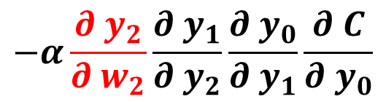
$$y_{4}$$
$y_{3}=w_{3} ∗y_{4}$
$y_{2}=w_{2} ∗y_{3}$
$y_{1}=w_{1} ∗y_{2}$
$y_{0}=w_{0} ∗y_{1}$
$$w_{3}$$
$$w_{2}$$
$$w_{1}$$
$$w_{0}$$
$−α$ $\frac{∂{ y}_{0}}{∂{ w}_{0}}\frac{∂ C}{∂{ y}_{0}}$
$$−α\frac{∂{ y}_{1}}{∂{ w}_{1}}\frac{∂{ y}_{0}}{∂{ y}_{1}}\frac{∂ C}{∂{ y}_{0}}$$
$$−α\frac{∂{ y}_{2}}{∂{ w}_{2}}\frac{∂{ y}_{1}}{∂{ y}_{2}}\frac{∂{ y}_{0}}{∂{ y}_{1}}\frac{∂ C}{∂{ y}_{0}}$$
$$−α\frac{∂{ y}_{3}}{∂{ w}_{3}}\frac{∂{ y}_{2}}{∂{ y}_{3}}\frac{∂{ y}_{1}}{∂{ y}_{2}}\frac{∂{ y}_{0}}{∂{ y}_{1}}\frac{∂ C}{∂{ y}_{0}}$$

Slide 38

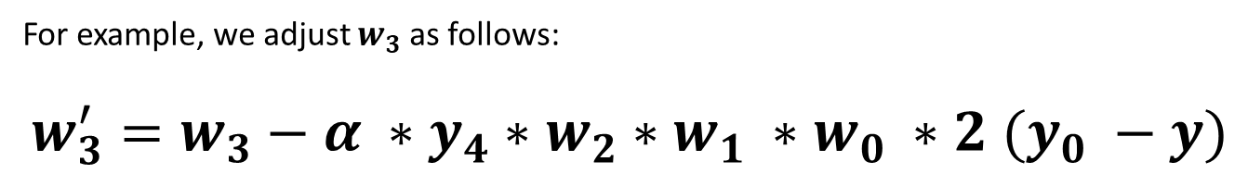
$$y_{4}$$
$y_{3}=w_{3} ∗y_{4}$
$y_{2}=w_{2} ∗y_{3}$
$y_{1}=w_{1} ∗y_{2}$
$y_{0}=w_{0} ∗y_{1}$
$$w_{3}$$
$$w_{2}$$
$$w_{1}$$
$$w_{0}$$
For example, we adjust $w_{3}$ as follows:
$w_{3}^{′}=w_{3}−α ∗y_{4}∗w_{2}∗w_{1} ∗w_{0} ∗2 (y_{0} −y)$
$$−α\frac{∂{ y}_{3}}{∂{ w}_{3}}\frac{∂{ y}_{2}}{∂{ y}_{3}}\frac{∂{ y}_{1}}{∂{ y}_{2}}\frac{∂{ y}_{0}}{∂{ y}_{1}}\frac{∂ C}{∂{ y}_{0}}$$

